Slide 1
Location finding for a food related Business in Toronto Ontario By Adebayo Ogunmoriyele August 5, 2019

Slide 2
Importance of Good Location for any Business
A business location could simply be defined as the place where it is situated.
There are several factors that need to be considered in choosing a location for a business.
One of the earliest decisions any entrepreneur must make is where to locate his or her business to break even easily. These factors are shown
A careful assessment of the area. The ideal location would be one where the targets are.
A proper look at the benefits which each area had to offer as well as other factors like security and Labor which might be available.
Many business owners have gone bankrupt because of poor location and choice of business.

Slide 3
The Problem to be solved
Toronto is a big City. Getting a good location for a good business manually could be:
Cumbersome
Tiering,
Discouraging,
Time consuming and
Could yield bad result at the end of the stress and money invested.
This project is based on finding different areas in the city of Toronto, ontario with their existing businesses in other to give my client who is interested in a food related business a professional advice on what to do and where to place it

Slide 4
Data acquisition and cleaning
Data was Scraped and extracted from https://en.wikipedia.org/wiki/List_of_postal_codes_of_Canada:_M which consist of list of postal codes in Canada where the first letter is M from the province of Ontario
Geospatial Coordinates which is hosted in https://github.com/Boyombo1/Cousera_Capstone/blob/master/Geospatial_Coordinates.csv
Foursquare location data was used to get different area names
103 rows and 3 columns was achieved after cleaning.
It means 103 areas was reviewed for proper location.

Slide 5
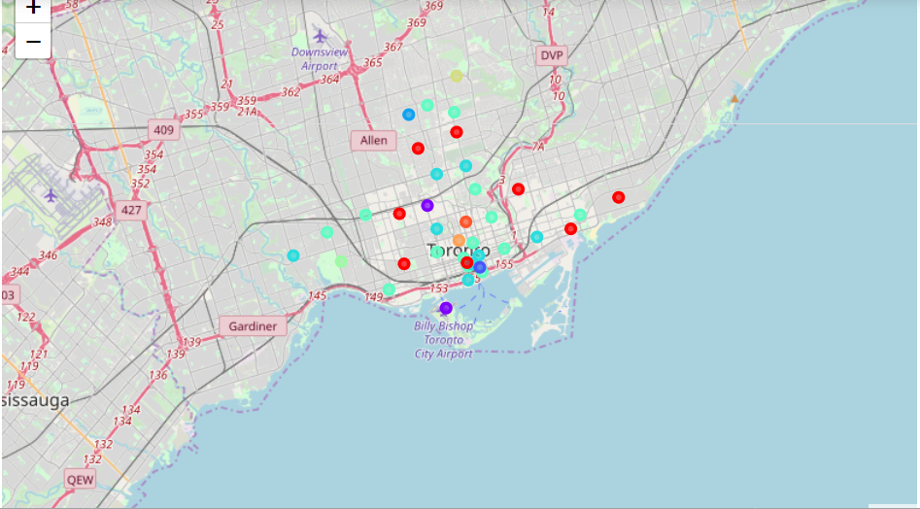
Machine Learning Algorithim
Kmeans algorithm was adopted in segmenting the clusters.
Kmeans was chosen because It Guarantees convergence
Can warm-start the positions of centroids.
With a large number of variables, K-Means may be computationally faster than hierarchical clustering (if K is small).

Slide 6
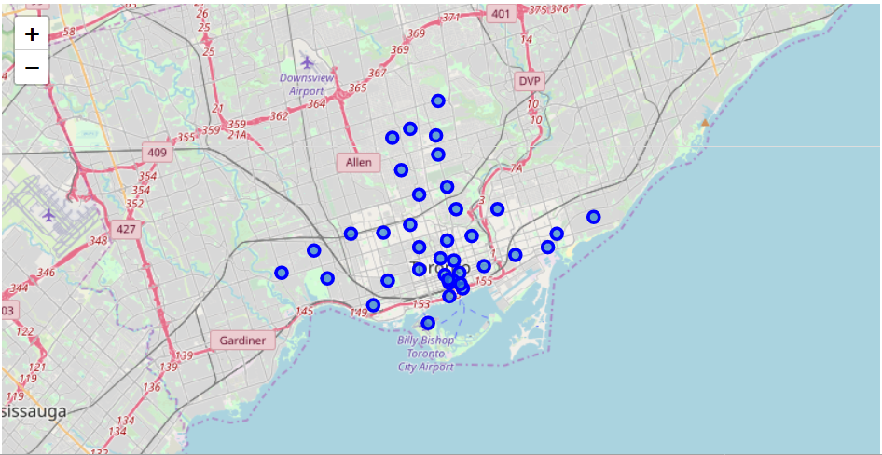
Clustering and Segmentation
Neighborhood needed to be clustered and segmented
The use of geolocator was adopted to get the right coordinates and cluster was achieved

Slide 7
Result and Discussion
Result
From the clustering and Segmentation, a total, 191 unique categories were achieved. From the data frame, the type of each business available in each area was gotten and recommendation was done
Discussion Section
From the analysis it was observed that different food businesses are existing in many of the neighborhood. If we are to go by factors affecting businesses in general which could be
The target customers, security, labor and competition. Starting a Bakery in Harbord,University of Toronto would be a very good idea because there is no bakery in the whole university, thus no initial competition. Security is guaranteed labor isn’t on the high side and the population is there.

Slide 8
Conclusion
From the analysis and report, we have noticed and discovered that a data driven business in survey and decision making is the best.
Special Thanks to Wikipedia, forsquare data collection and also to cousera
Thank You

